Slide 1
Marvel Superhero
A website to search your favorite Marvel superhero
Presented by Brandon Lauer & Roberto Di Biase

Slide 2
Background
Purpose / Problems solved
Give the Marvel fans a place where they can obtain information on their favorite superhero series and comics.
They can also retrieve all YouTube videos related to their superhero or to the comics.

Slide 3

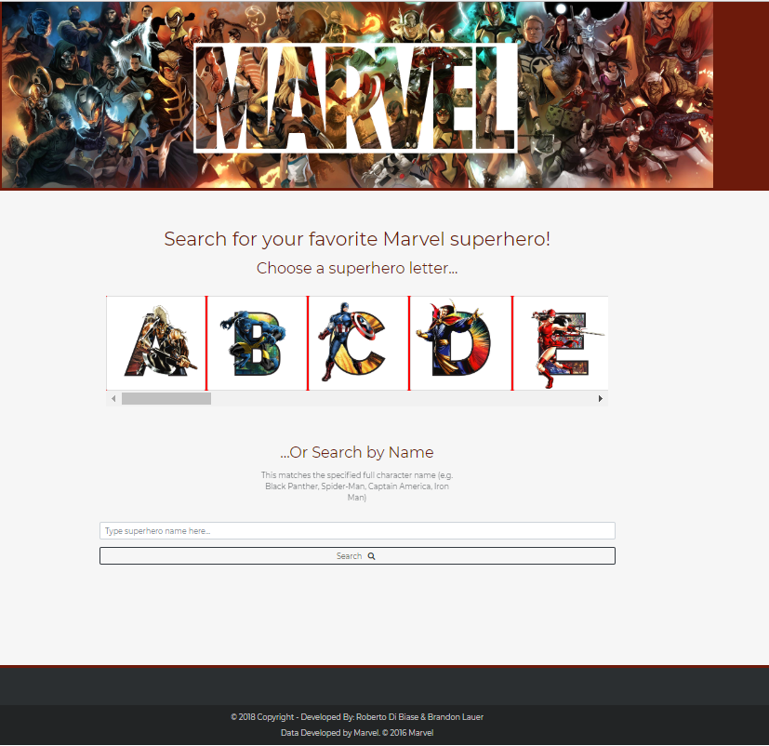
Solution overview

Slide 4
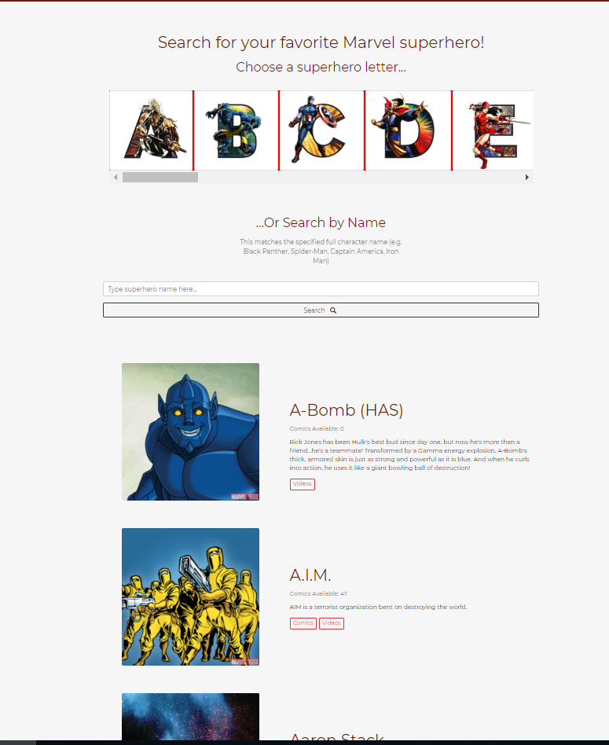
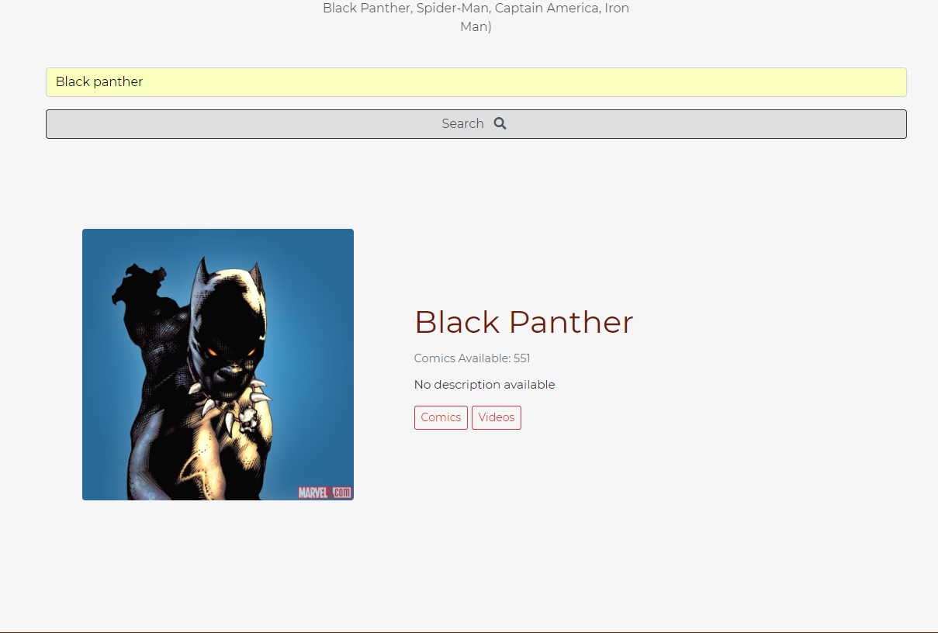

Slide 5
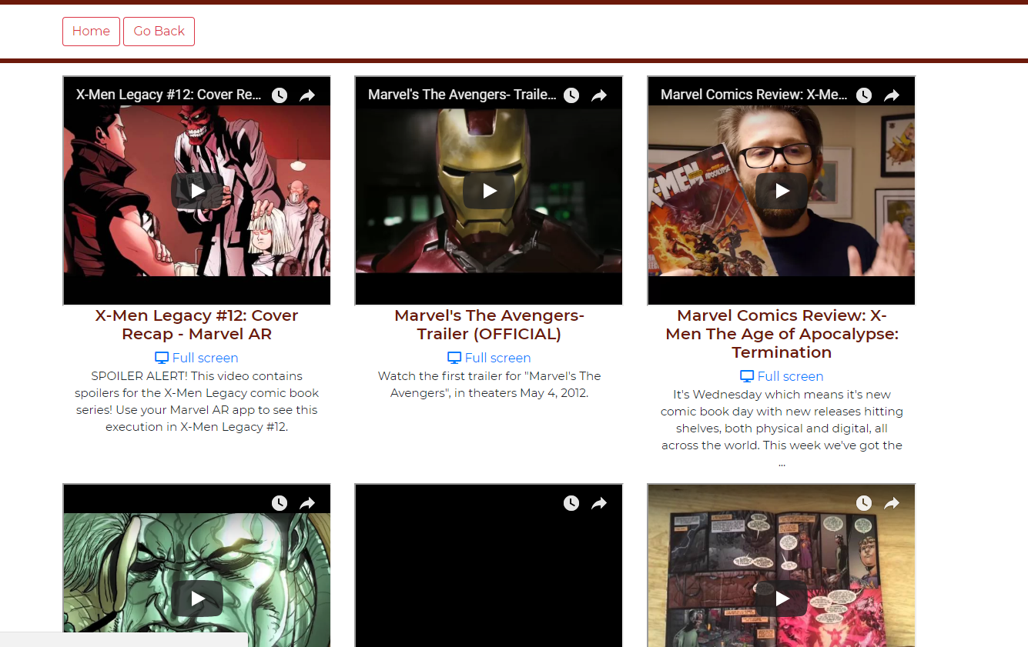
Video results

Slide 6
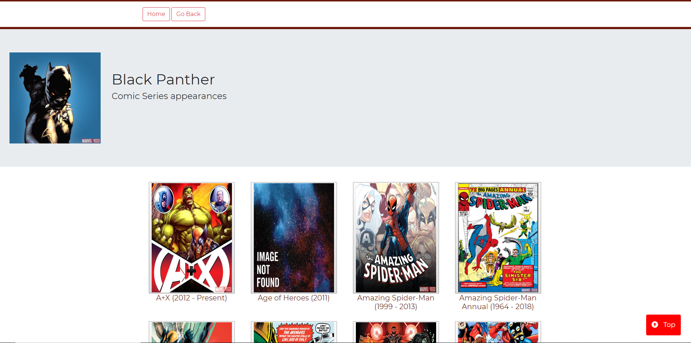
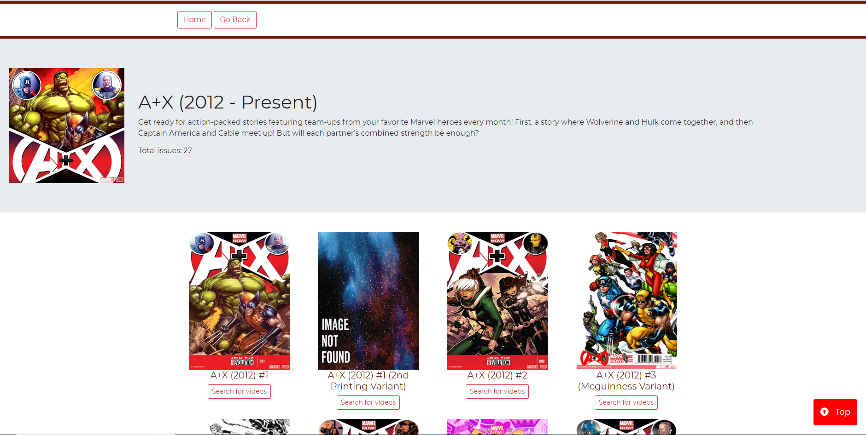
Comic Series
Displays all the comic Series were the selected superhero appears
Comics
Displays all comics from the selected series

Slide 7
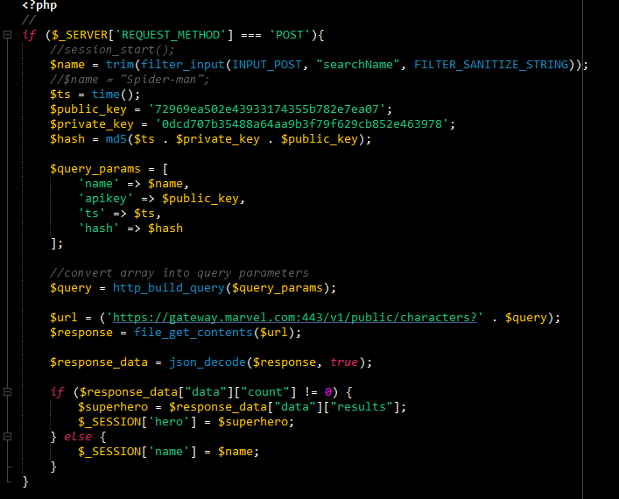
Challenges / What we learned

Slide 8
LIVE DEMO

Slide 9
Summary
Features in our Marvel website:
Search by superhero name
Filter by letter
Look for corresponding series and comics
Look for corresponding YouTube videos

